Slide 1

School of Computing Science and Engineering
Course Code : BSCS2470 Name: CRYPTOGRAPHY AND NETWORK SECURITY
NETWORK SECURITY: SECURITY ATTACKS
GROUP MEMBER
ANUJ PANDEY
HARSH KUMAR
SARTHAK DHAMA
Program Name : BSC

Slide 2
SECURITY ATTACKS
According to the OSI Architecture X.800, security attacks can be classified in two categories:
passive attacks, and
active attacks

Slide 3
SECURITY ATTACK
A passive attack attempts to learn or make use of information from the system but does not affect system resources.
An active attack attempts to alter system resources or affect their operation.

Slide 4
PASSIVE ATTACK
Passive Attacks:
A passive attack attempts to learn or make use of information from the system but does not affect system resources
Passive attacks are in the nature of eavesdropping on, or monitoring of, transmissions.
The goal of the opponent is to obtain information that is being transmitted.

Slide 5
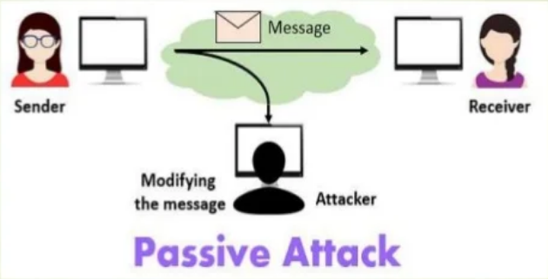
PASSIVE ATTACKS

Slide 6
NUMERIACL METHODS FOR PROBLEM SOLVING
There are two types of passive attacks
release of message contents, and
traffic analysis.

Slide 7
PASSIVE ATTACK
Release of message contents:
A telephone conversation, an e-mail message, and a transferred file may contain confidential info. Prevent an opponent from learning contents of these transmissions.
Traffic Analysis:
Even if contents of messages are encrypted, an opponent might still be able to observe the pattern of these messages.
He could determine the location and identity of communicating hosts and could observe the frequency and length of messages being exchanged.
He can guess the nature of the communication.

Slide 8
PASSIVE ATTACK
Passive attacks do not alter the data.
Neither the sender nor receiver is aware that a third party has observed the traffic pattern.
Emphasis is on prevention rather than detection.
Use Encryption.

Slide 9
ACTIVE ATTACK
Active Attacks:
An active attack attempts to alter system resources or affect their operation
Active attacks involve some modification of the data stream or the creation of a false stream

Slide 10
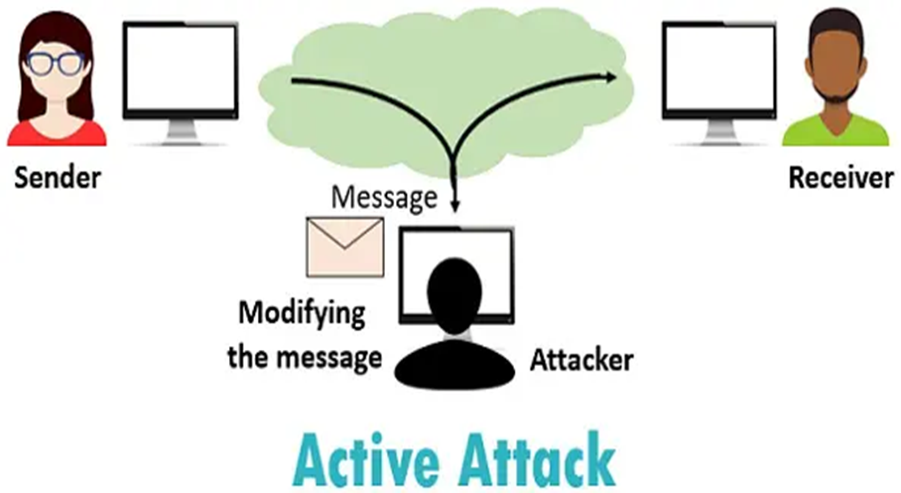
ACTIVE ATTACK

Slide 11
ACTIVE ATTACK
Active attacks can be subdivided into four categories:
masquerade,
replay,
modification of messages, and
denial of service.

Slide 12
ACTIVE ATTACK
Masquerade:
It takes place when one entity pretends to be a different entity.
It usually includes one of the other forms of active attack.
Replay:
It involves the passive capture of a data unit and its subsequent retransmission to produce an unauthorized effect.

Slide 13
ACTIVE ATTACK
Modification of messages:
It simply means that some portion of a legitimate message is altered, or that messages are delayed or reordered, to produce an unauthorized effect.
Denial of Service:
It prevents or inhibits the normal use or management of communications facilities.
E.g. an entity may suppress all messages directed to a particular destination.

Slide 14
ACTIVE ATTACK
Active Attacks are difficult to prevent because of the wide variety of potential physical, software, and network vulnerabilities.
Goal is to detect attacks and to recover from any disruption or delays caused by them.

Slide 15


